Slide 1

FRY-McVEAN GOLD CLAIMS FOR OPTION
2-MILE DRILL READY GEOCHEMICAL AND GEOPHYSICAL GOLD TARGET
IN PICKLR LAKE GOLD REGION, PROLIFIC UCHI GOLD BELT

Slide 3
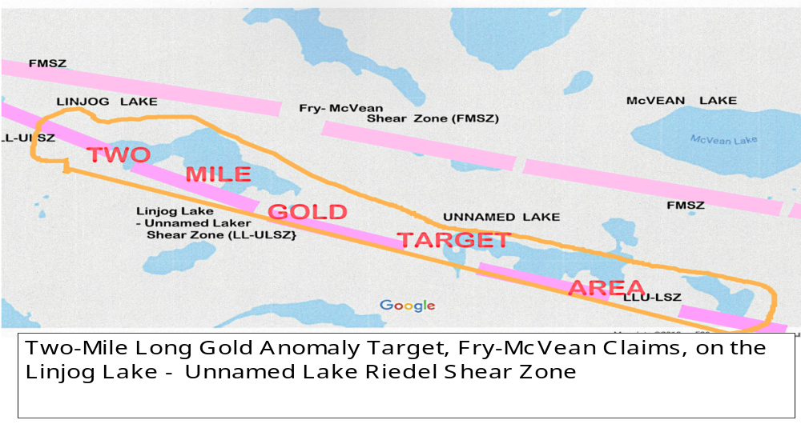

Slide 4
This presentation deals with the following:
Gold anomalies and other indicator anomalies on the Fry-McVean claims in northwestern Ontario – 2 MILE DRILL TARGET
Dilationa; Riedel shear zone detected from VLF-EM conductors as a dilational gold host structure that extends over 8.5 km on strike.
The identification of 56 gold indicator anomaly sample stations over a 3.2 + km (2-mile) length on an 8.5 km-long Riedel shear structure open on strike.
Together with co-extensive anomalous molybdenum (64), iron (90), arsenic (20), bromine (47) and antimony (35) indicator element sample stations. With Au this totals 312 indicator element anomalies.
Probably two and possibly three sub-parallel mineralized zones.

Slide 6
A Ground VLF-EM winter survey over 17 lines or 1 mole of strike length
completed in 2020 showed:
Good correspondence between gold in humus anomalies and strong Karous-Hjelt Current Density Anomalies 50 to 100 metres wide as drill targets on the 2-mile plus anomalous gold target corridor (500 m by 3200 m plus) over 1600 m strike
Additional Karous-Hjelt Current Density Anomalies 50 to 100 metres wide as drill targets under the ice of Linjog Lake and Unnamed Lake on the northern edge of the above anomalous gold corridor on the 17 line VLF-EM survey
The 500 m by 3200 m anomalous gold corridor is open to the east for an additional 2.5 miles or 4 km.

Slide 7
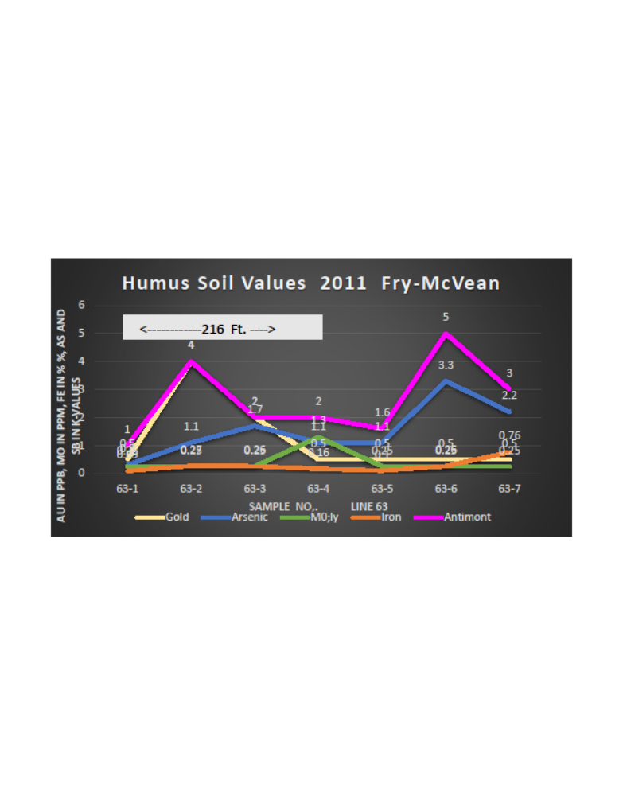
LINE 63 HUMUS SOIL PROFILE WITH ANOMALOUS GOLD AT 2 STATIONS- 216 Ft Wide South is to the Right

Slide 8
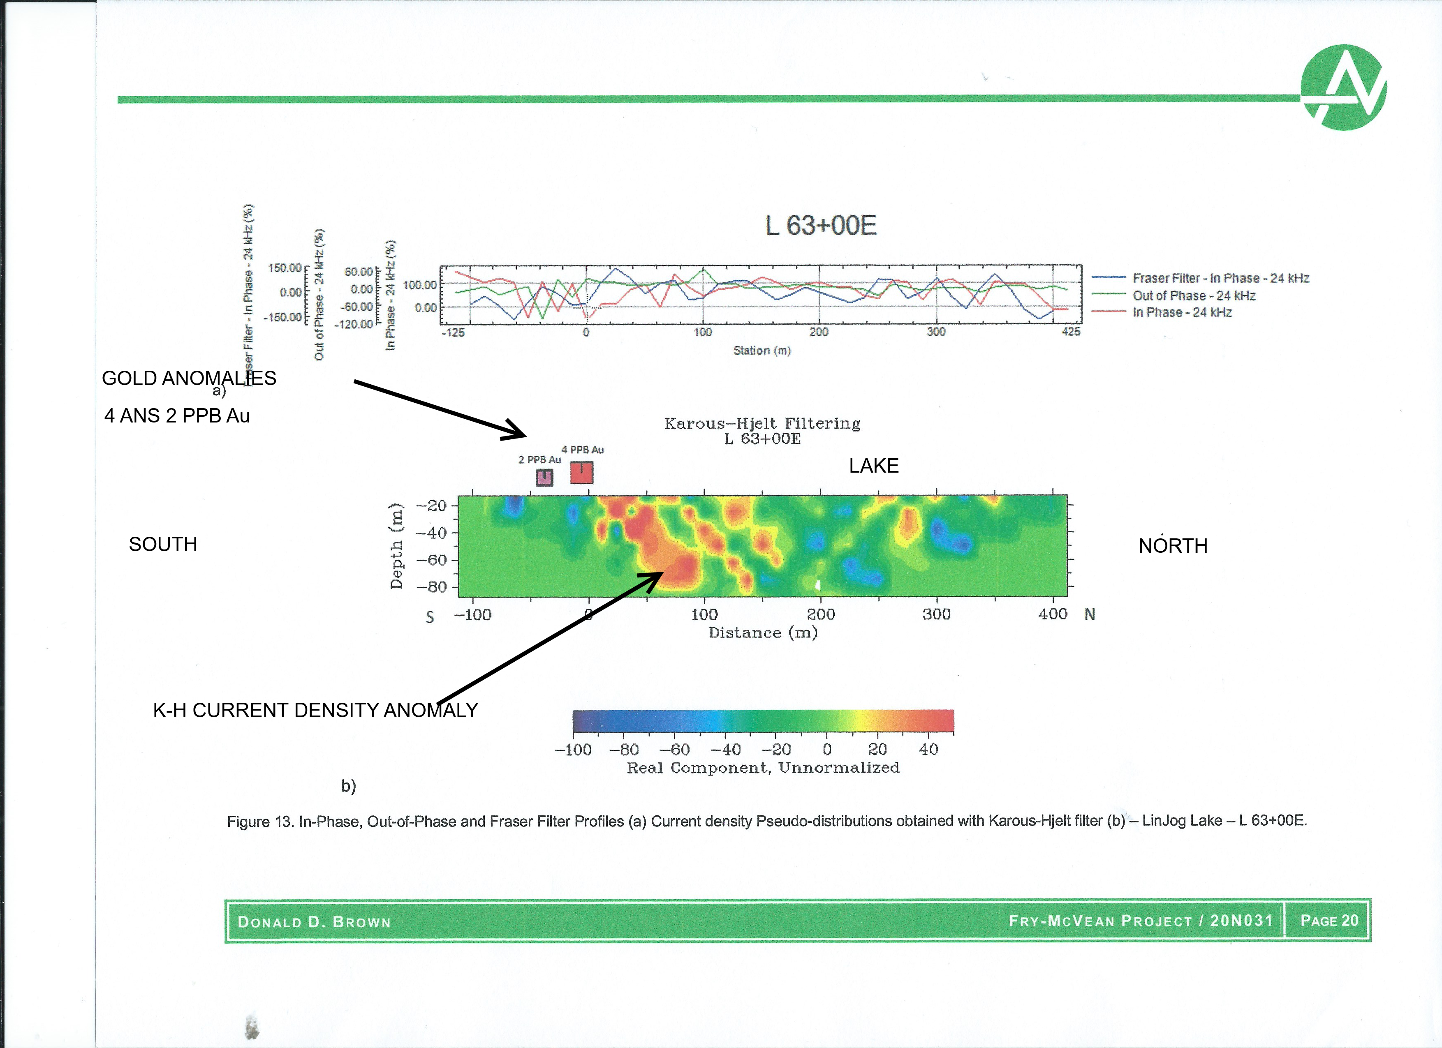
K-H CURRENT DENSITY ANOMALY IN RED
50 M Wide with Gold Down-Ice to South By 50 m
LINE 63 South is to the Left

Slide 9
Conclusions and Recommendation
There is general good correspondence between the gold in humus soil anomalies and the VLF-EM Karous-Hjelt (K-H) current density anomalies. The high current density values can be indicative of sulphide mineralization in shear zones that are indicated by Fraser cross overs.
A number of the K-H anomalies are 50 to 100 m wide showing a potential for wide mineralized zones.
A number of wide K-H anomalies are located under Linjog Lake and Unnamed Lake. They are north of and running parallel to the 2-mile LL-ULSZ gold zones shown on slides 7 and 18.
Some of the gold in humus anomalies could be displaced as much as 50 to 100 m to the south by glacial dispersion, and therefore be offset from the corresponding K-H current density anomaly.

Slide 10
Conclusions and Recommendation
5. The anomalies should be drill tested in mid winter for winter road access from Pickle Lake.
6. The areas under Linjog Lake and Unnamed Lake and the anomalous areas to the south of the lakes could be surveyed by a distributive IP survey in January-February of the year before diamond drilling.

Slide 11
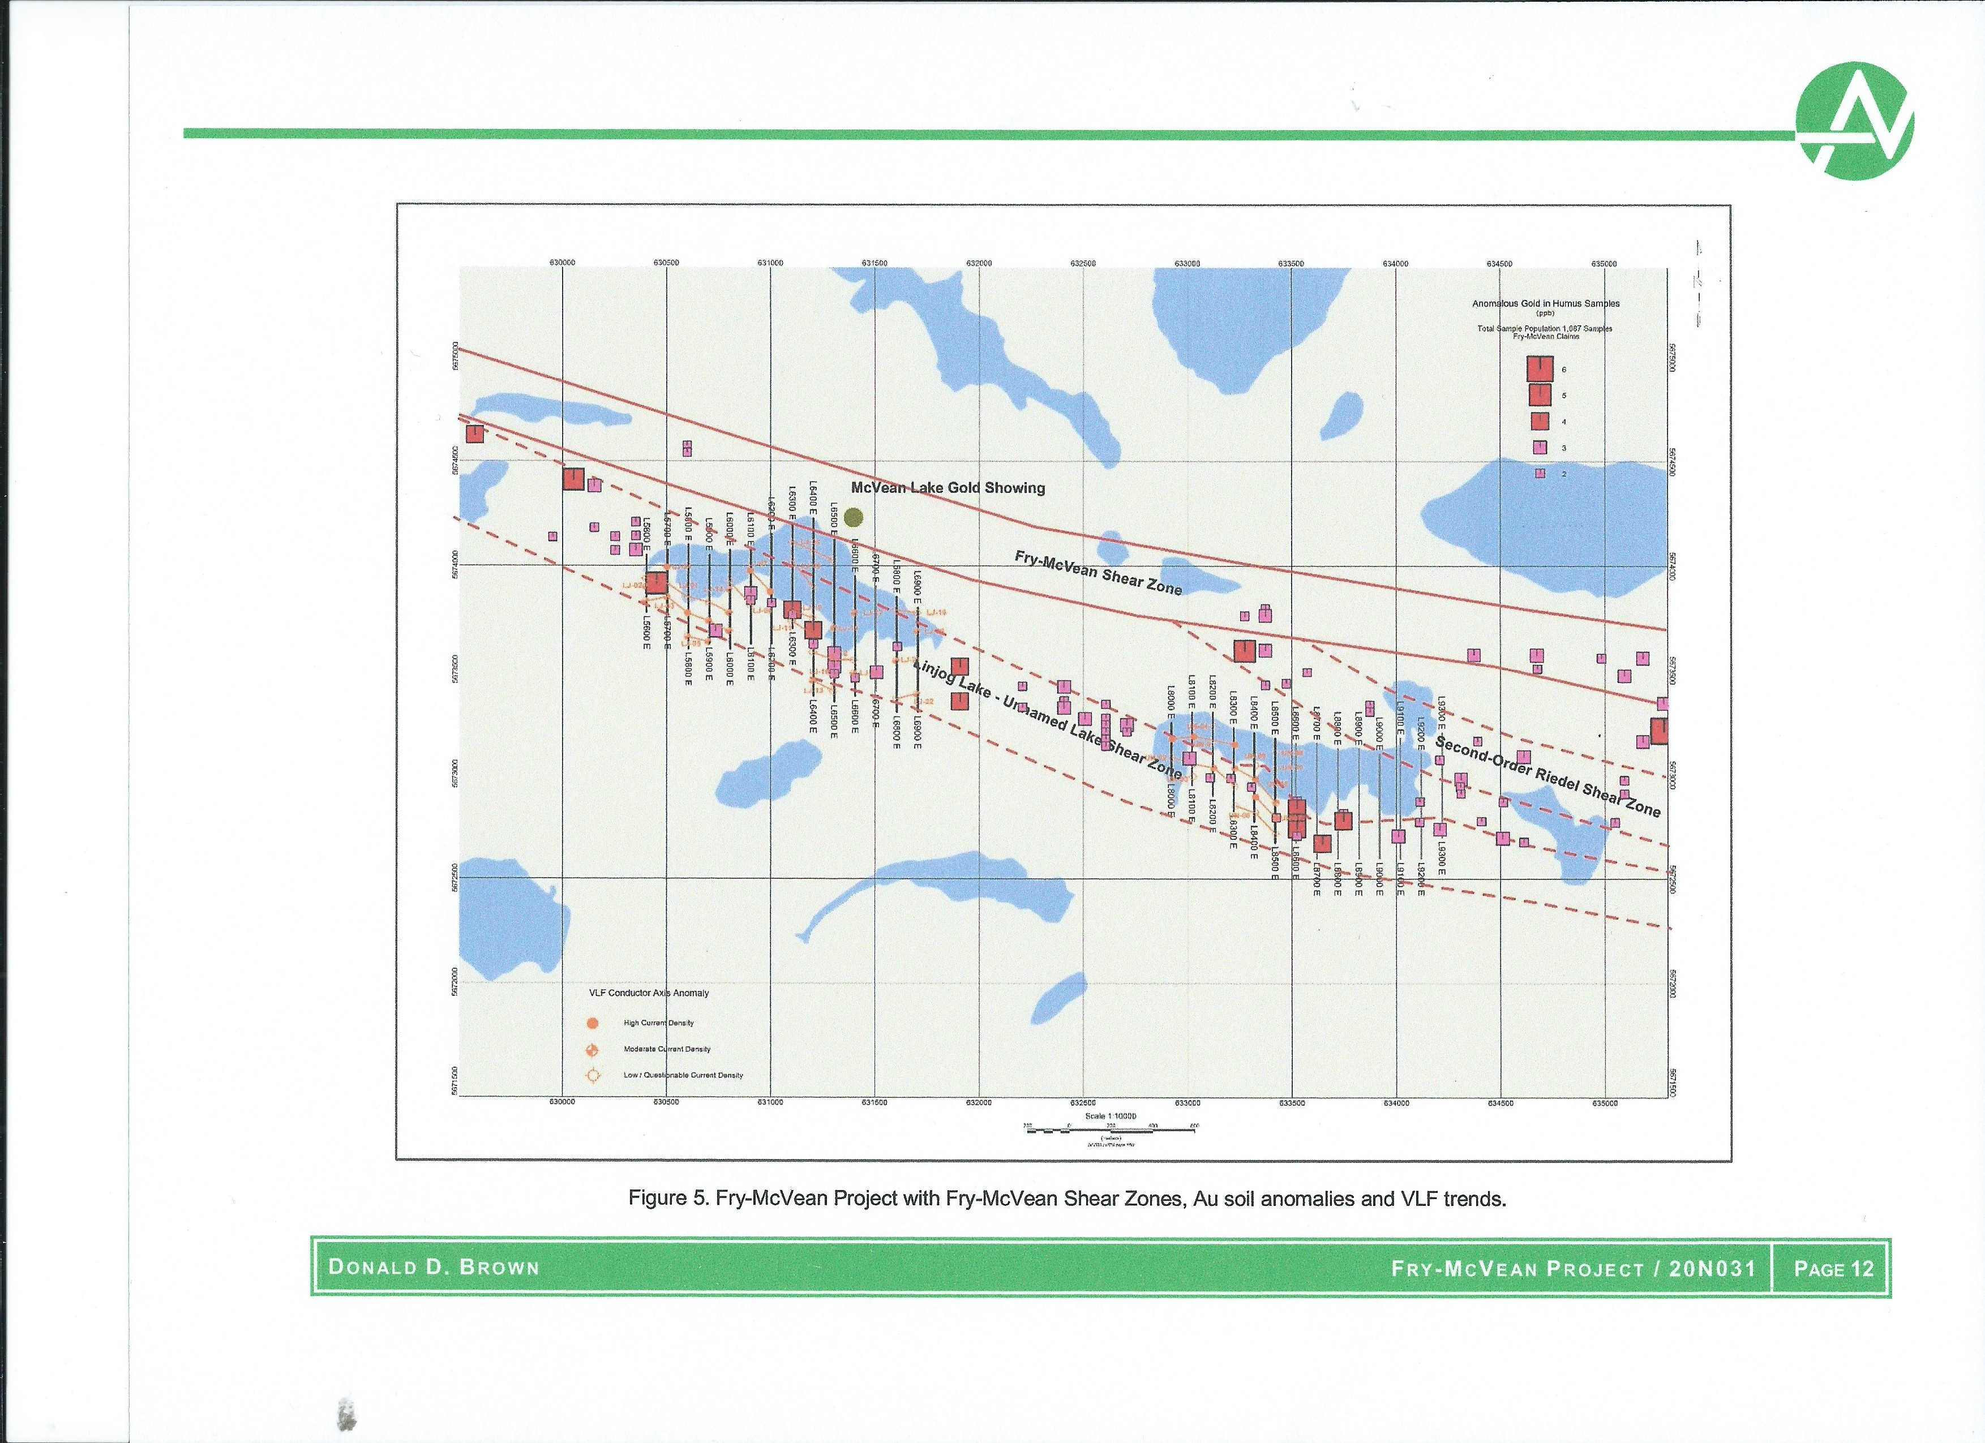
ABITIBI GEOPHYSICS VLF- EM SURVEY ON FRY-McVEAN
CLAIMS 2020 – Gols Anomalies on 3 Shear Zones

Slide 12
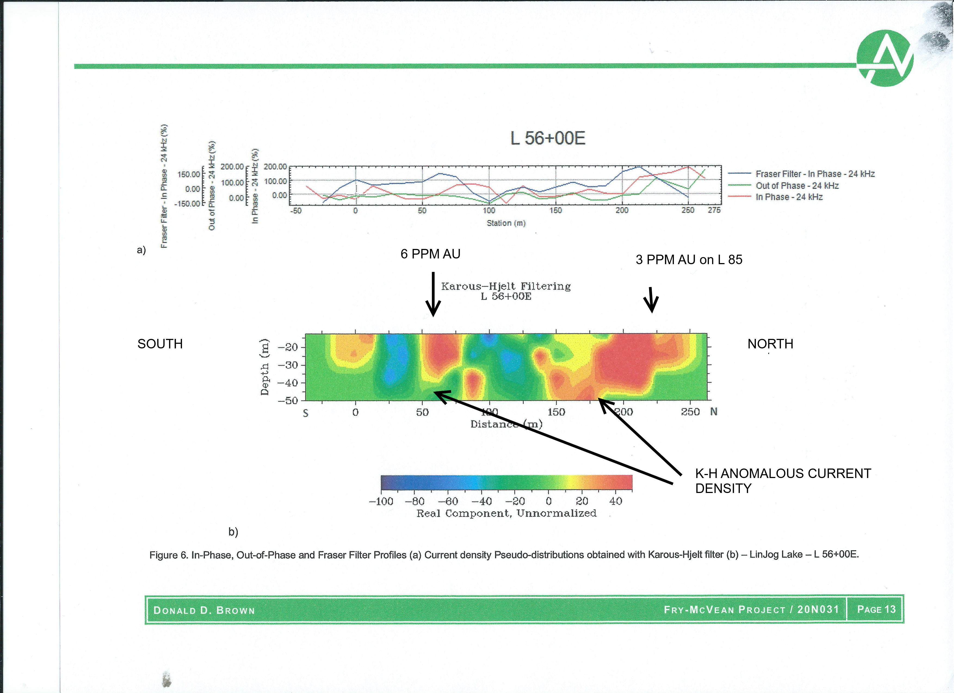
THE RED K-H CURRENT DENSITY ANOMALY > 100 M WIDE IS UNDER LIMJOG LAKE AT 200 N

Slide 13
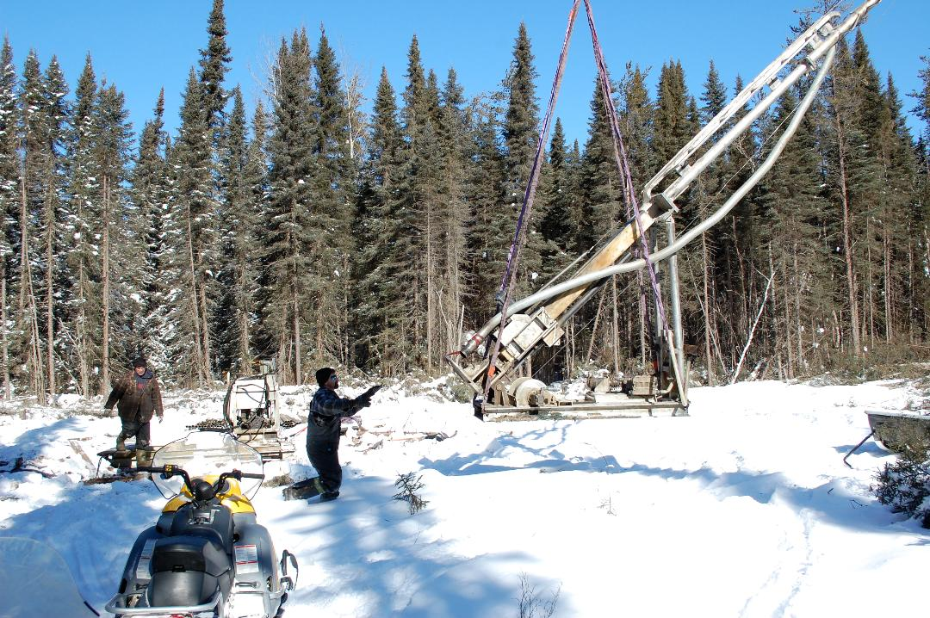
This location is 8 miles to the northeast of the 2-mile target area Access is by Winter Road from Pickle Lake

Slide 14
CONTACT FOR DETAILED POWER POINTS AND OTHER INFORMATION
Donald Brown, Ph.D. P.Geo. (non-practicing)
Geologist & Property Owner
  Email : dbrown9874@rogers.com
  Tel: +1(613) 746-9873

